Slide 1

Sahara 24*7 – Web App to provide instant information on Hospital Availability and Services Working Link For Website - https://secure-stream-61176.herokuapp.com/
Team Brute Force
M Shiva Pavan Kalyan
Nidhi Rana
Shipra Gupta
Sahil Kukreja

Slide 2

Sahara 24*7
Problem Statement - To Build an API which can provide details on hospitals/Medical Facility with details like oxygen capacity, ICU Bed and Ventilator availability and required details based on the search criteria. It will also allow healthcare workers to update the information for the medical facility
Description – Sahara 24*7 is a web application which provides Patients or common people an option to search the Medical Facility available in any state and city in India and give the information on the available Oxygen Capacity, Number of ICU beds, Number of Ventilators and available medicines related to COVID and POST COVID recovery. Also, this online application will provide healthcare workers an option to update the information for their respective medical Facility at any point of time.

Slide 3
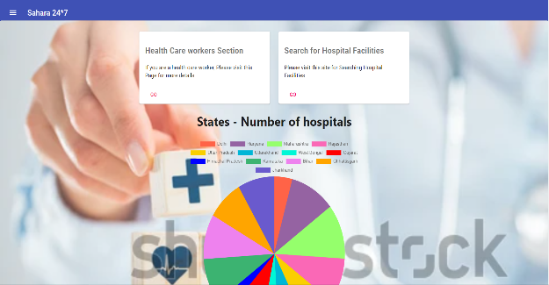
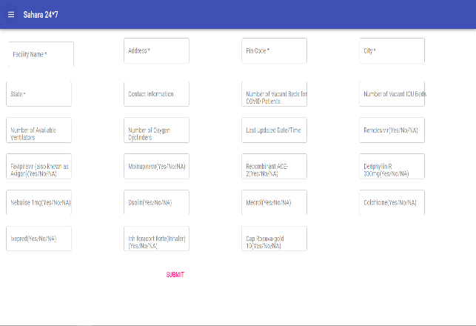
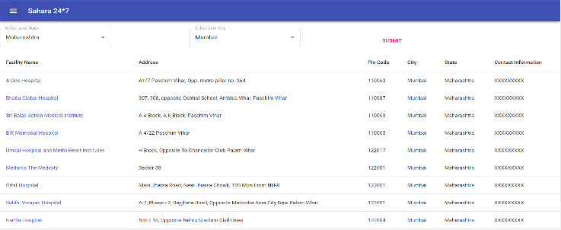
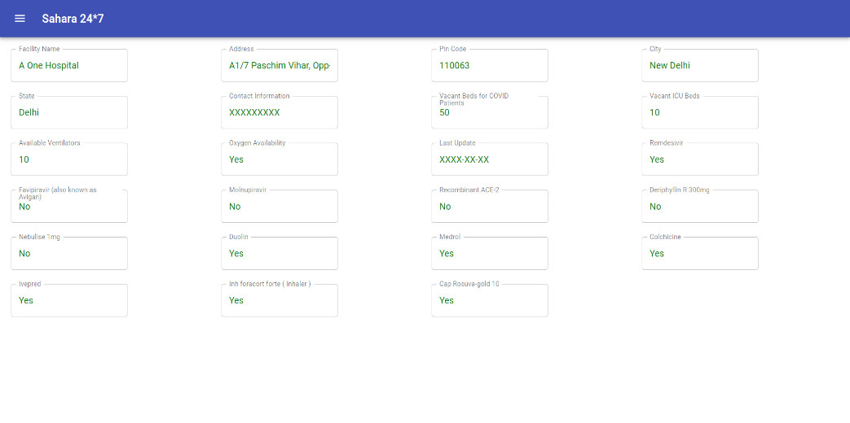
Sahara 24*7
Health Care Professionals
Patient or Common People
Dashboard
Updated Information send to the Database
After Selection of Hospital

Slide 4
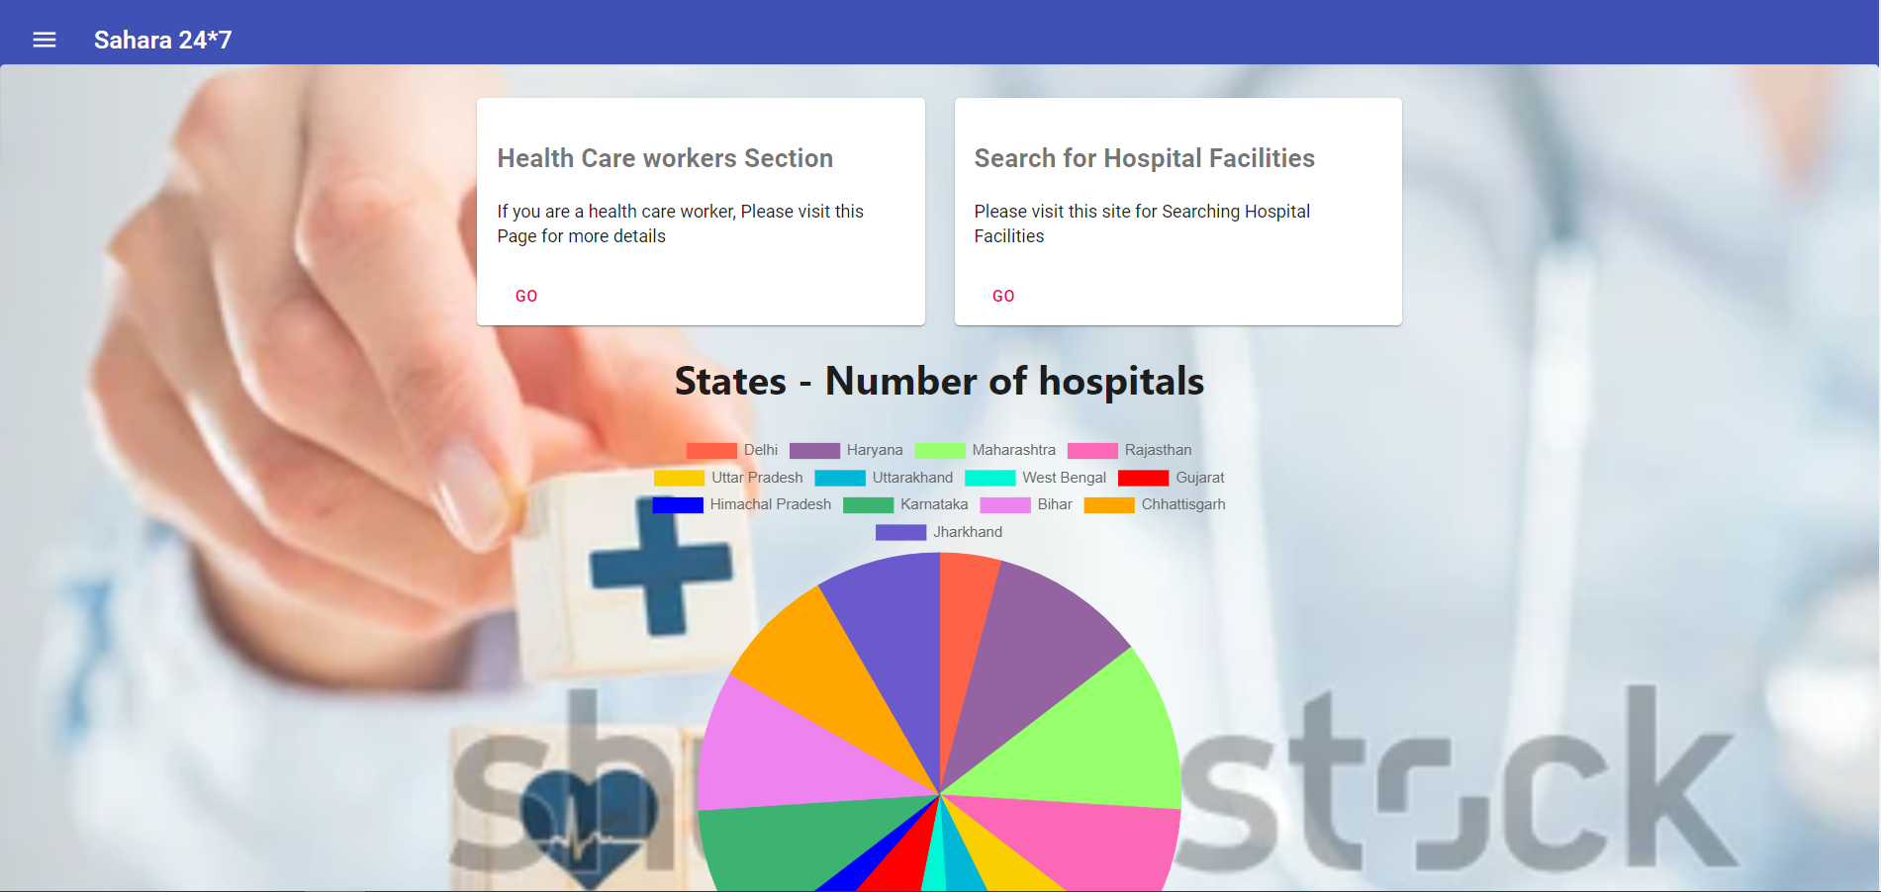
Sahara 24*7
Dashboard

Slide 5
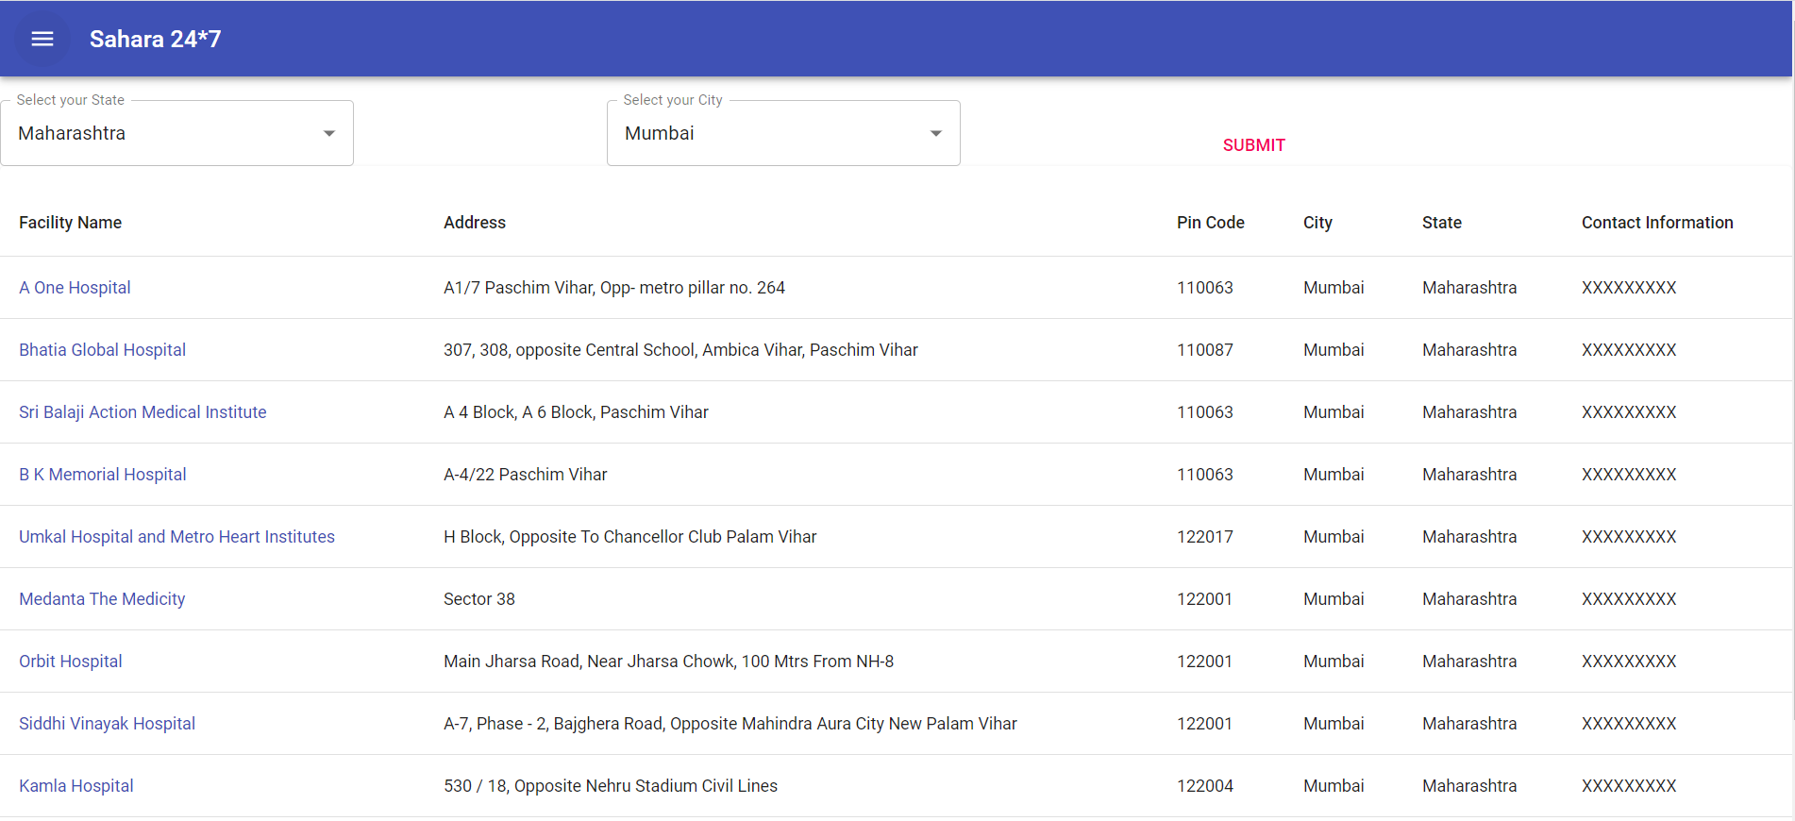
Sahara 24*7
Hospital/ Medical Facility Search Page

Slide 6
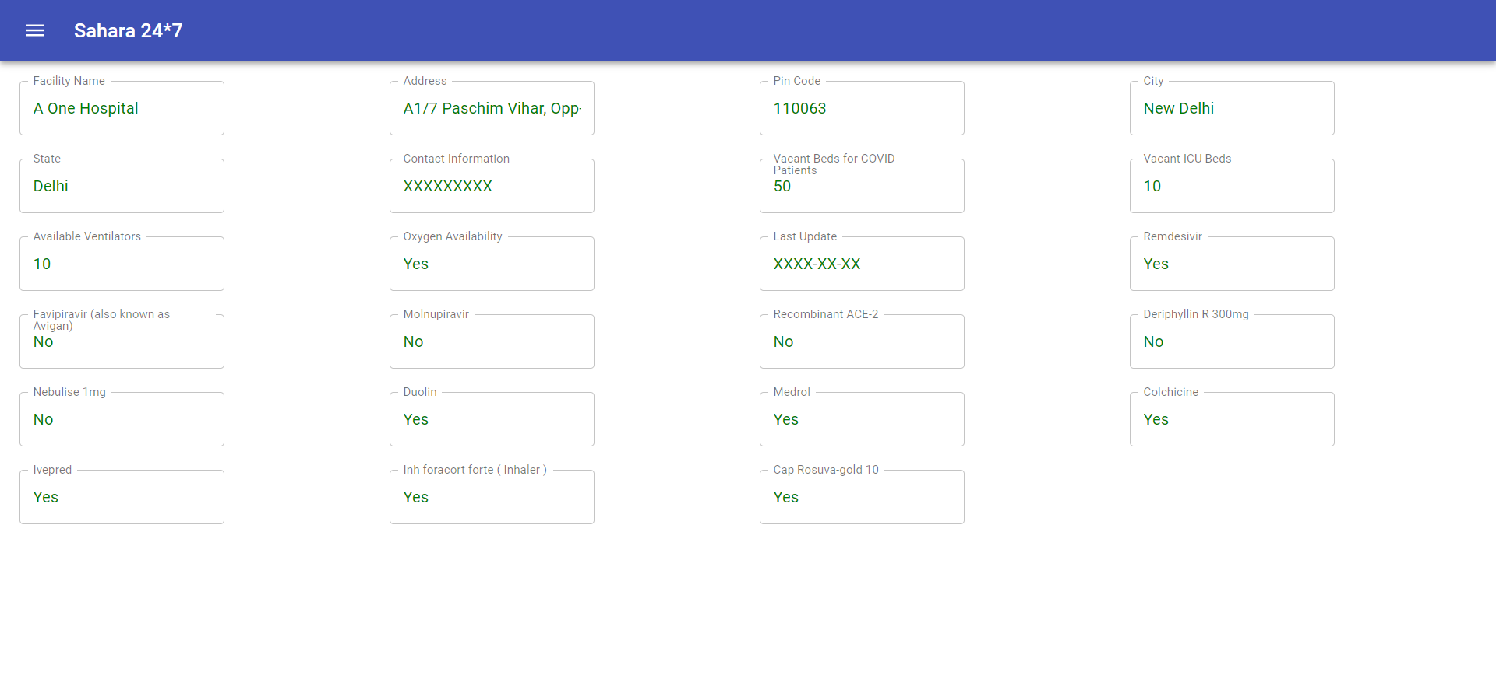
Sahara 24*7
Hospital/ Medical Facility Details

Slide 7
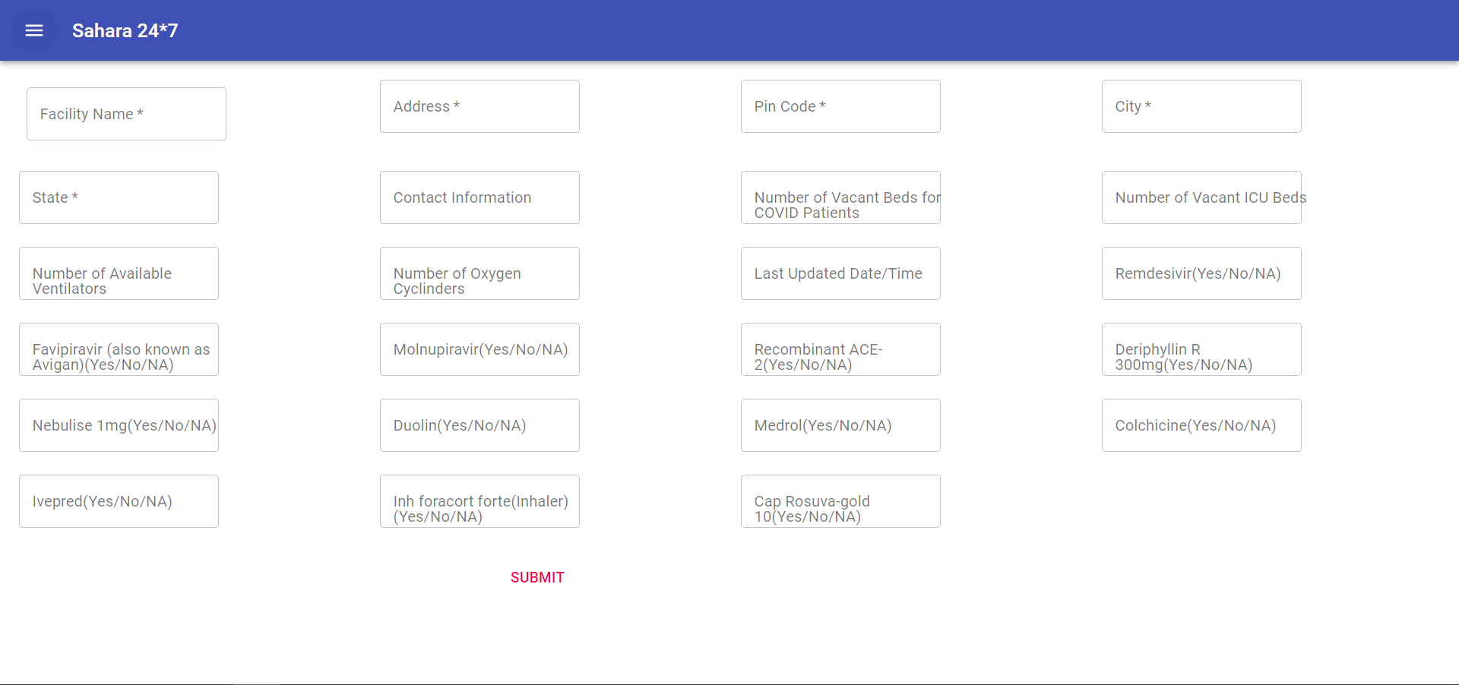
Sahara 24*7
Healthcare Workers Data Input Page

Slide 8
Sahara 24*7
Architecture Overview
Technologies Used In Frontend:
ReactJS
Material-UI
Technologies Used In Backend:
Python
FastAPI
Cloud Provider Used for deployment
Heroku(https://www.heroku.com/)

Slide 9
Sahara 24*7 Roadmap
List of Testing Centers / Pathology
Information of nearby testing centers
Book appointment for sample collection from home
Vendors/Suppliers
Oxygen Cylinders Suppliers
Oxygen Concentrator Suppliers
Nearby Medical Stores
Basic essentials suppliers
Doctor’s Appointment
Online Appointments with doctors
Emergency Contact of standby doctors
Book appointments for visiting doctor’s Clinic or hospital
OHFS & OHCS Operations
Booking Vaccination Appointments
Vaccination appointments
Information related to Vaccine
Best practices to follow before and after vaccine
Started Operations in May 2010 with ID Cards process
Added more of non-claims businesses

Slide 10
Sahara 24*7
Advantages of Sahara 24*7
User-friendly site with easy to access anywhere.
Easiness in searching the data of Hospitals with available beds and services.
Working links to provide real time information or recently update information.
Establishing bridge between demand and supply. ( For example. : Patients looking for beds and hospitals putting information about vacant beds )
Single click away with standby Doctors, nearby Pathology or Vendors.
Booking Online appointments for vaccines.
One step site for all the necessary services in this pandemic times.

Slide 11
THANK YOU

